Slide 1

MOBILE AUTOMATION WITH APPIUM
Muhammmed Yahya Avar 1921221004

Slide 2
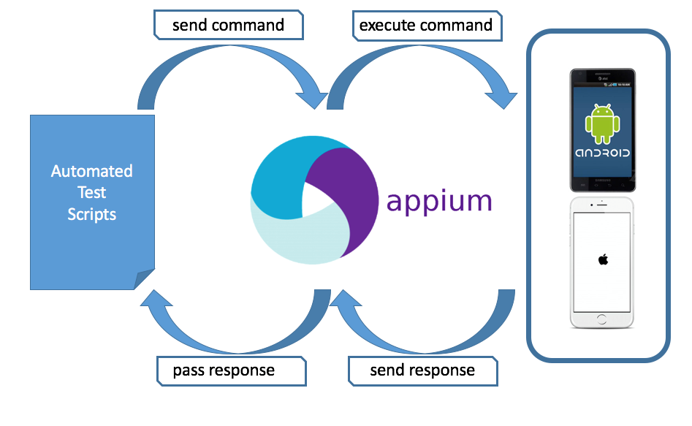
What Is Appium?
Appium is an open source automation tool for running scripts and testing native applications, mobile-web applications and hybrid applications on Android or iOS using a webdriver.
Appium is "cross-platform": it allows you to write tests against multiple platforms using the same API. This enables code reuse between iOS, Android, and Windows testsuites.

Slide 3
Appium Philosophy
You shouldn't have to recompile your app or modify it in any way in order to automate it.
You shouldn't be locked into a specific language or framework to write and run your tests.
A mobile automation framework shouldn't reinvent the wheel when it comes to automation APIs.
A mobile automation framework should be open source, in spirit and practice as well as in name!

Slide 4
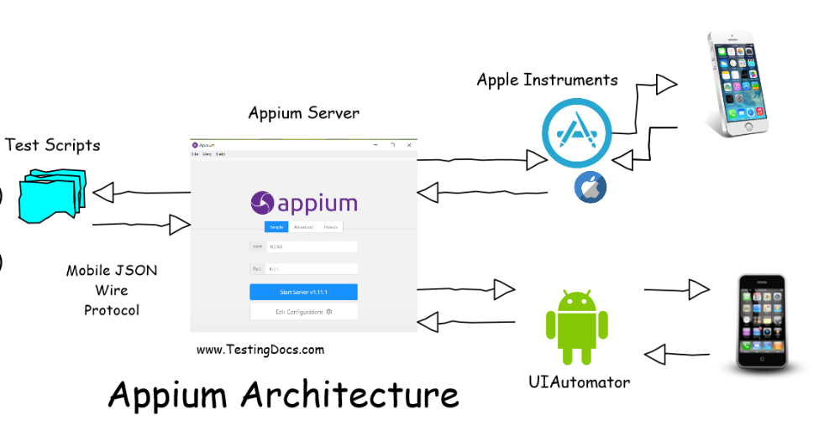
Appium Concepts

Slide 5
Client/Server Architecture
Appium is at its heart a webserver that exposes a REST API. It receives connections from a client, listens for commands, executes those commands on a mobile device, and responds with an HTTP response representing the result of the command execution.

Slide 6
Session
Automation is always performed in the context of a session. Clients initiate a session with a server in ways specific to each library, but they all end up sending a POST/session request to the server, with a JSON object called the 'desired capabilities' object. At this point the server will start up the automation session and respond with a session ID which is used for sending further commands.

Slide 7
Desired Capabilities
Desired capabilities are a set of keys and values (i.e., a map or hash) sent to the Appium server to tell the server what kind of automation session we're interested in starting up. There are also various capabilities which can modify the behavior of the server during automation.

Slide 8
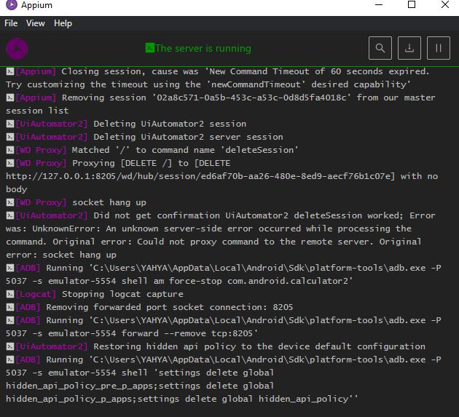
Appium Server

Slide 9
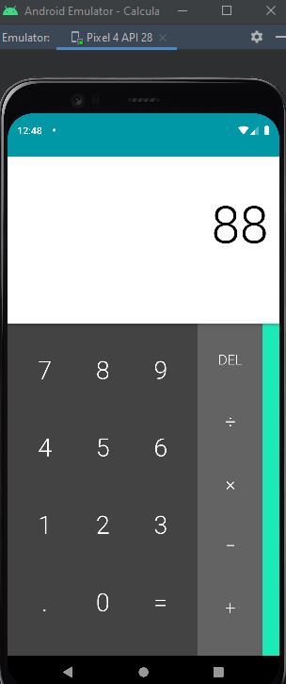
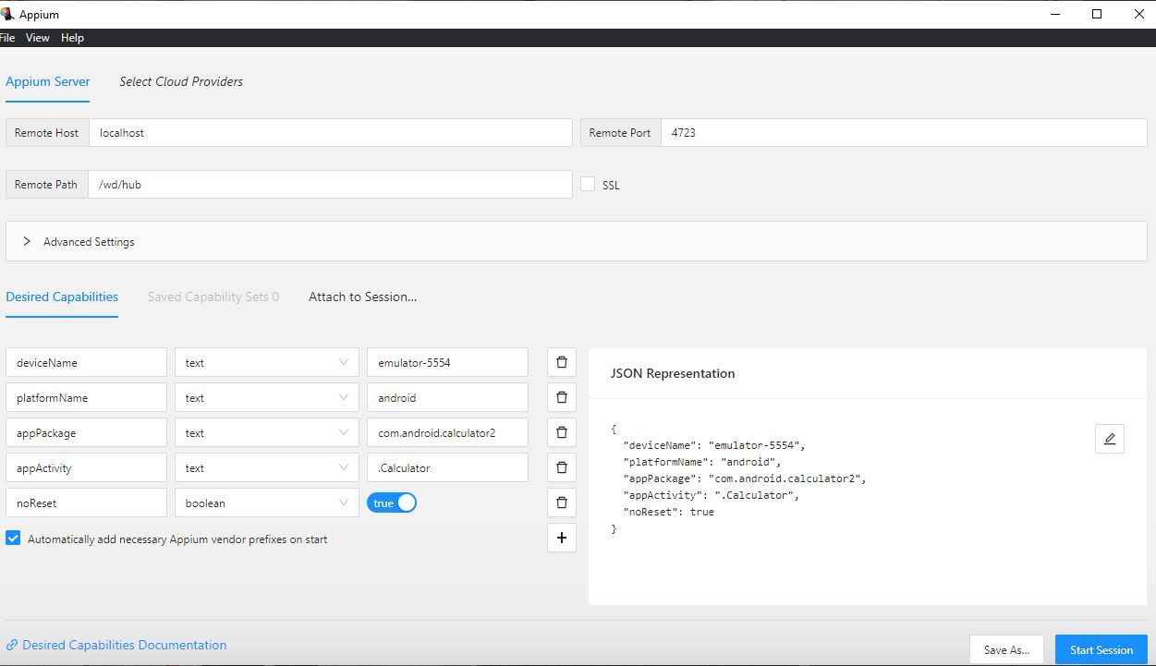
Appium Inspector

Slide 10
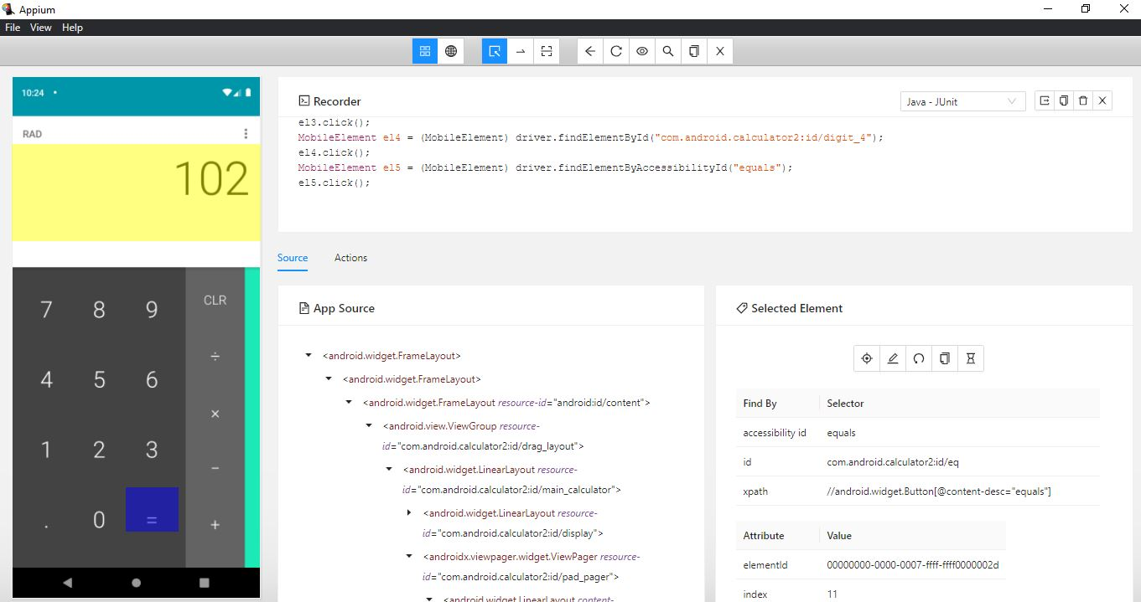

Slide 11
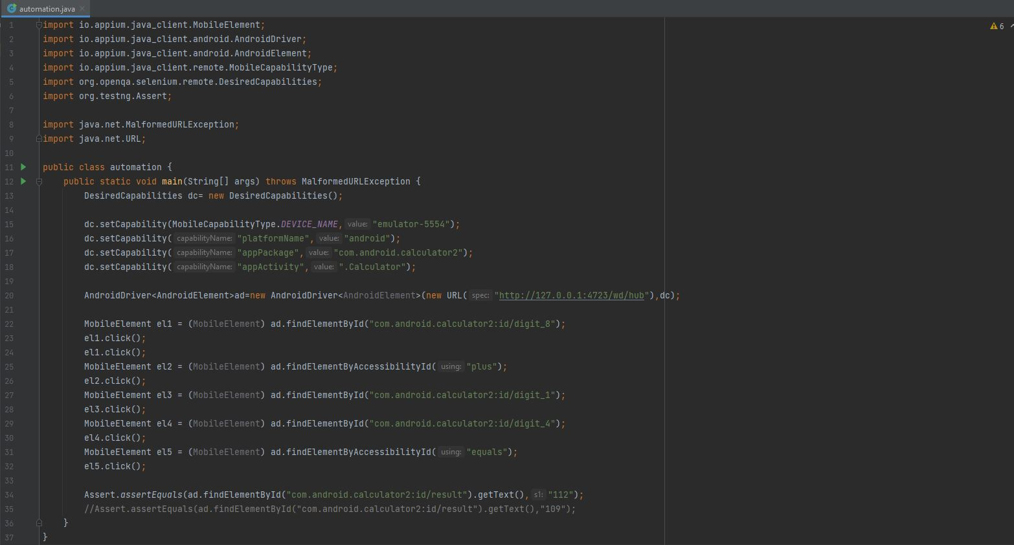
Automation Example

Slide 12
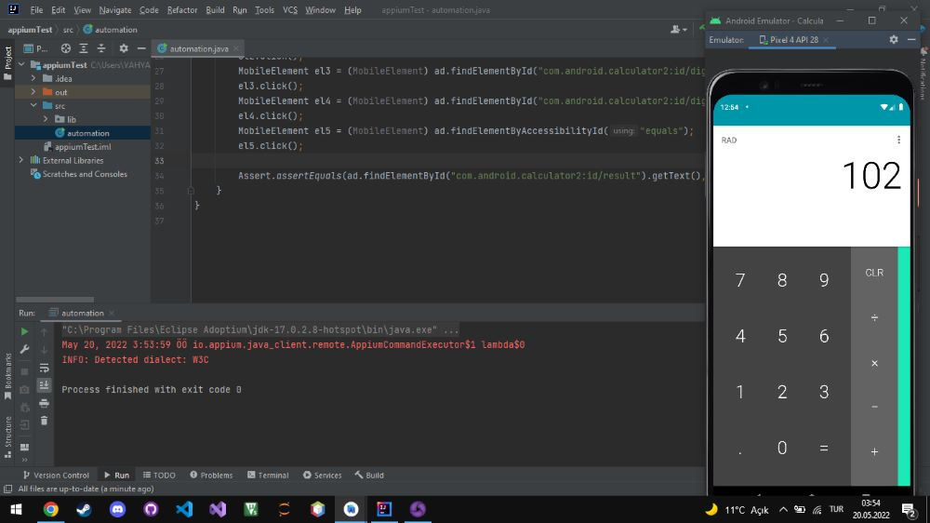

Slide 13
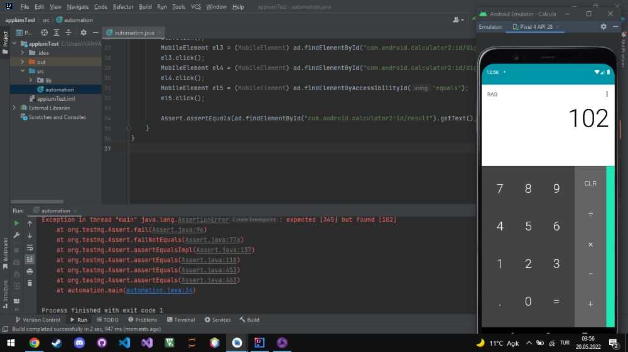

Slide 14
Overview
Pros
Cons
It allows the test scripts to be executed simultaneously.
Appium also contains a recording tool to record test cases and a playback tool for running such recorded tests.
Various elements can be tested simultaneously (like emulators, real devices, and simulators).
It is used for native app, hybrid app, and mobile web app testing.
Offers an excellent user interface application to assist in designing cases by previewing app screens and retrieving names of the elements you intend on interacting with
There were some cases when Appium caused the application under test to crash.
The setup process is very difficult for new users.
Element browser sometimes is unreliable and has sporadic fails.
A skilled automation tester is necessary in order to build the quality code for automating mobile test cases.

Slide 15

Alternatives
Kobiton: Kobiton has created its own Appium server and removed all the ‘fluff’. Not only does Kobiton support Appium, but Kobiton also offers a faster solution when leveraging Appium scripts. With AI-driven Scriptless Automation that can be converted into Appium scripts, and AI-assisted Appium automation, you can easily make the move and/or scale your mobile test automation with Kobiton & Appium.

Slide 16
Thanks for lIstenIng

